Slide 1
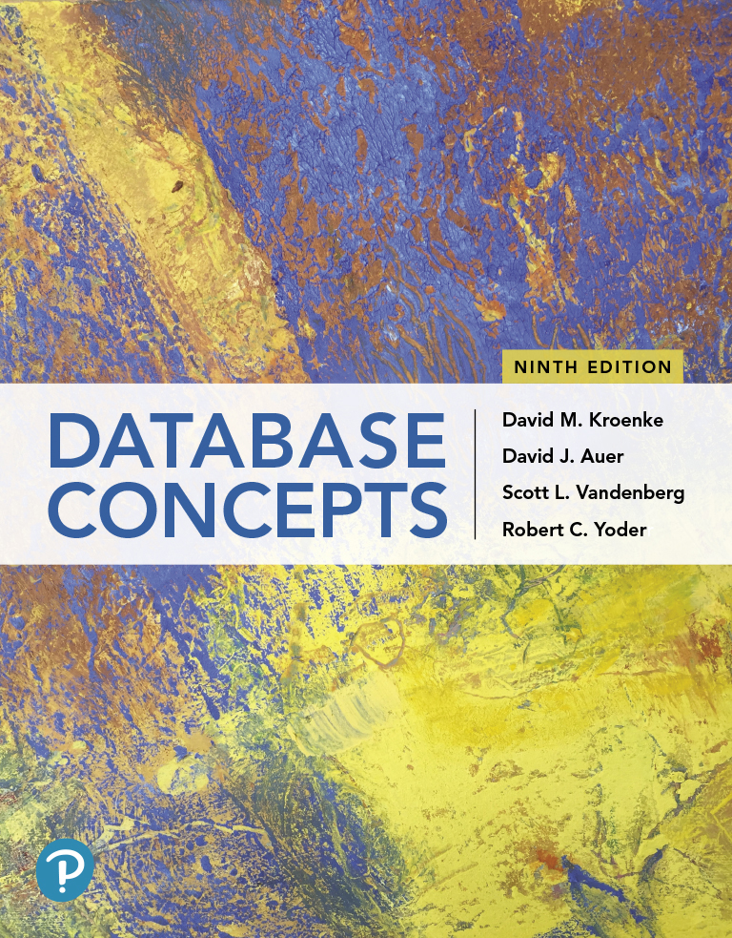
Database Concepts
Ninth Edition
Chapter 6
Database Administration
Copyright © 2020, 2017, 2015 Pearson Education, Inc. All Rights Reserved
Notes:
If this PowerPoint presentation contains mathematical equations, you may need to check that your computer has the following installed:
1) Math Type Plugin
2) Math Player (free versions available)
3) NVDA Reader (free versions available)

Slide 2
Learning Objectives (1 of 2)
Understand the need for and importance of database administration
Know basic administrative and managerial D B A functions
Understand the need for concurrency control, security, and backup and recovery
Learn about typical problems that can occur when multiple users process a database concurrently
Understand the use of locking and the problem of deadlock
Learn the difference between optimistic and pessimistic locking
Know the meaning of A C I D transaction
Learn the four 1992 A N S I standard isolation levels
Learn different ways of processing a database using cursors

Slide 3
Learning Objectives (2 of 2)
Understand the need for security and specific tasks for improving database security
Know the difference between recovery via reprocessing and recovery via rollback/rollforward
Understand the nature of the tasks required for recovery using rollback/rollforward

Slide 4
Data Administration Terms
Understand the need for and importance of database Administration
Data administration refers to a function that applies to an entire organization concerning corporate data privacy and security issues.
Database administration refers to a more technical function that is specific to a particular database, including applications associated with it.
Database administrator (D B A) refers to the person in charge of a database and facilitates the development of use of it.

Slide 5
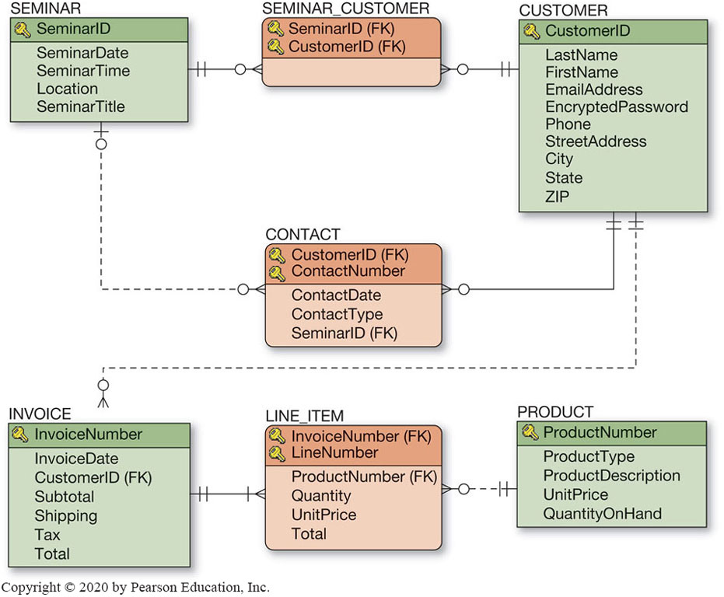
Figure 5.27 Heather Sweeney Designs: Database Design
Note: From the previous chapter showing the final database design for Heather Sweeney

Slide 6
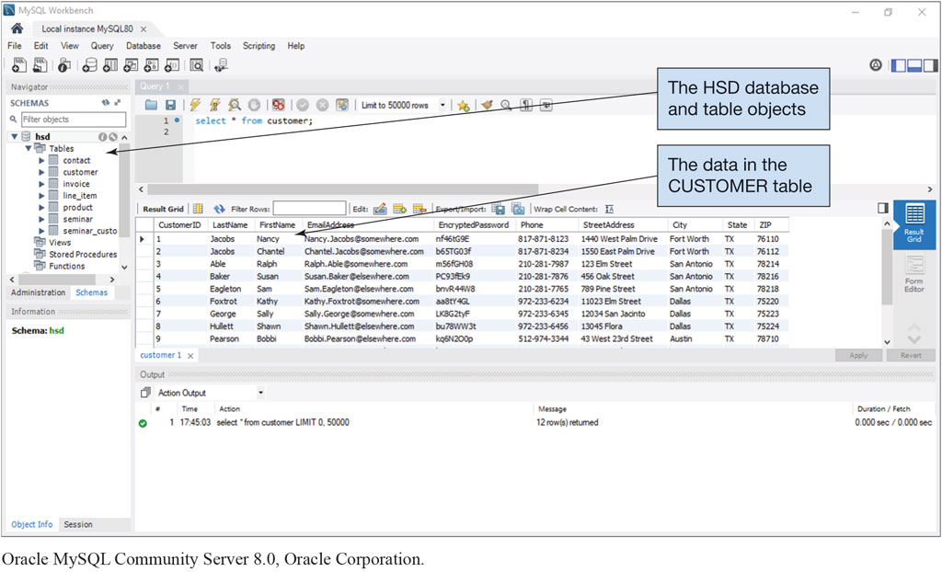
Figure 6.1 The H S D Database in MySQL Workbench
Oracle MySQL Community Server 8.0, Oracle Corporation

Slide 7
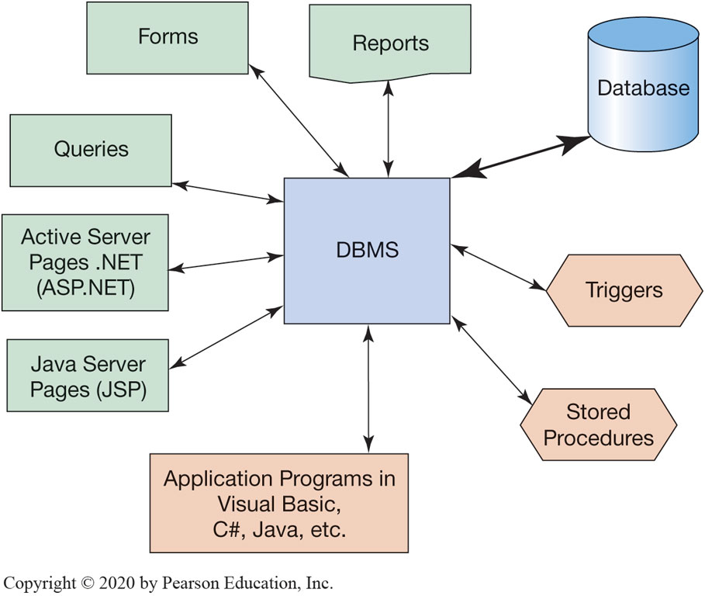
Figure 6.2 The Database Processing Environment

Slide 8
Concurrency Control
Understand the need for concurrency control, security, and backup and recovery
Concurrency control ensures that one user’s work does not inappropriately influence another user’s work.
Users should be able to enter an order and get the same result whether there are no other users, or hundreds of other users.
No concurrency control technique is ideal for all circumstances, they all involve trade-offs.
Strict concurrency requires locking the database, thus not allowing any other user (high price to pay)
Other measures allow more throughput (maximum rate of processing) but has a lower concurrency control

Slide 9
The Need for Atomic Transactions
Understand the need for concurrency control, security, and backup and recovery
Users submit work in the form of transactions, also know as logical units of work (L U W s).
An atomic transaction is one where a series of actions are taken on a database such that all of them are performed successfully or none of them are performed at all.
An example of an atomic transaction is:
Change the customer transaction, increasing the value of Amount Owed.
Change the salesperson record, increasing the value of Commission Due.
Insert the new-order record into the database.

Slide 10
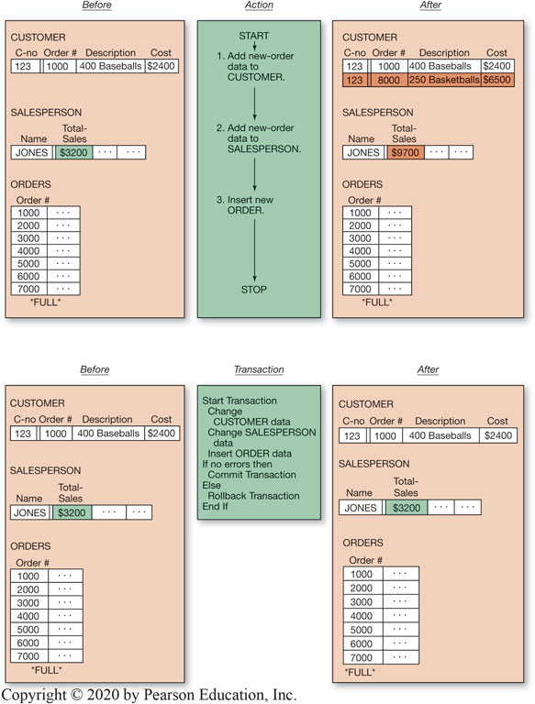
Figure 6.3 Comparison of the Results of Applying Serial Actions Versus a Multiple-Step Transaction

Slide 11
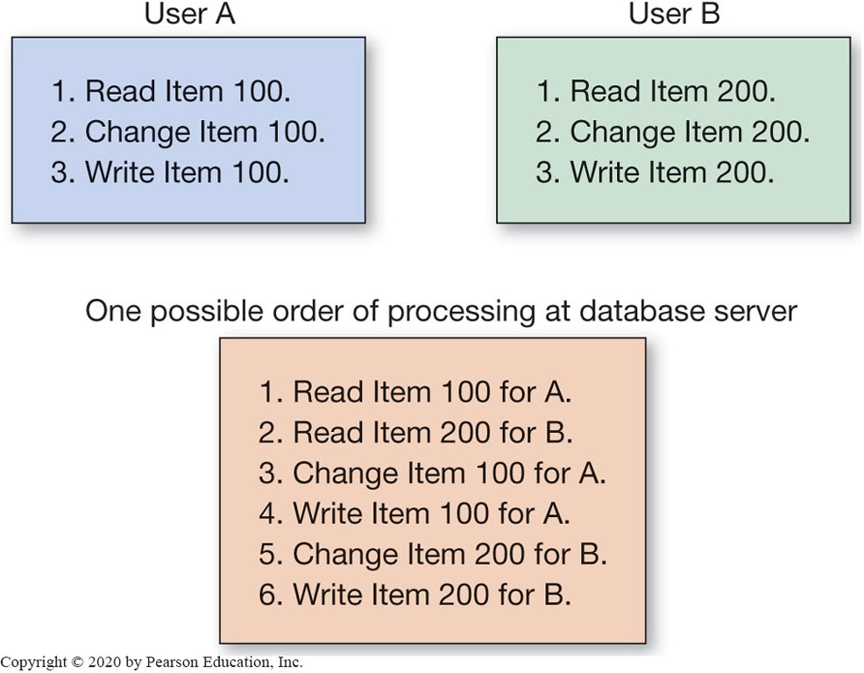
Figure 6.4 Example of Concurrent Processing of Two Users’ Tasks

Slide 12
Lost Update Problem
Learn about typical problems that can occur when multiple users process a database concurrently
If two users are attempting to update the same piece of data at the same time, it is possible that one update may overwrite the other update.
If one user’s update overwrites the other’s, this is called a lost update problem (concurrent problem).
If one user reads data that have been processed by only a portion of another user’s transaction, this is called a inconsistent read problem.

Slide 13
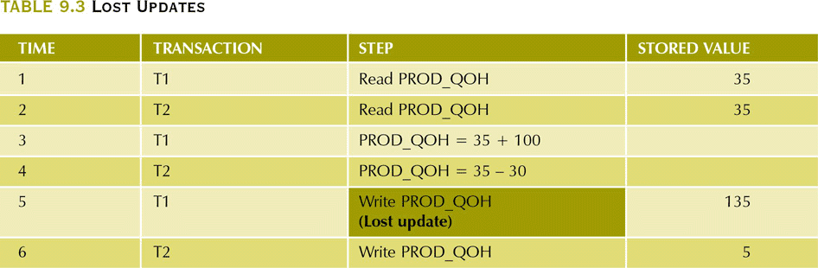
Lost Updates

Slide 14
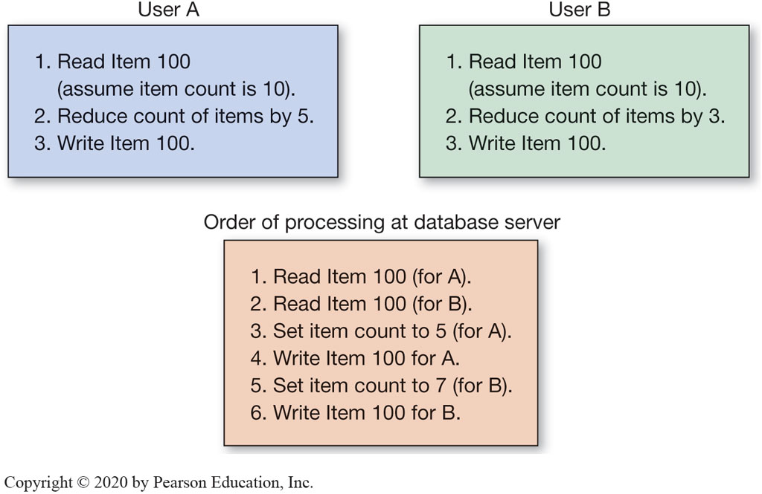
Figure 6.5 Example of the Lost Update Problem

Slide 15
Resource Locking
Understand the use of locking and the problem of deadlock
Resource locking prevents concurrent processing problems by disallowing sharing by locking data that are retrieved for update.
Locks placed by the DBMS are called implicit locks, while those placed by command are called explicit locks.
Exclusive lock locks an item from access of any type.
No other transaction can read or change the data
A shared lock locks an item from being changed but not from being read.
Other transactions can read the data but not alter it

Slide 16
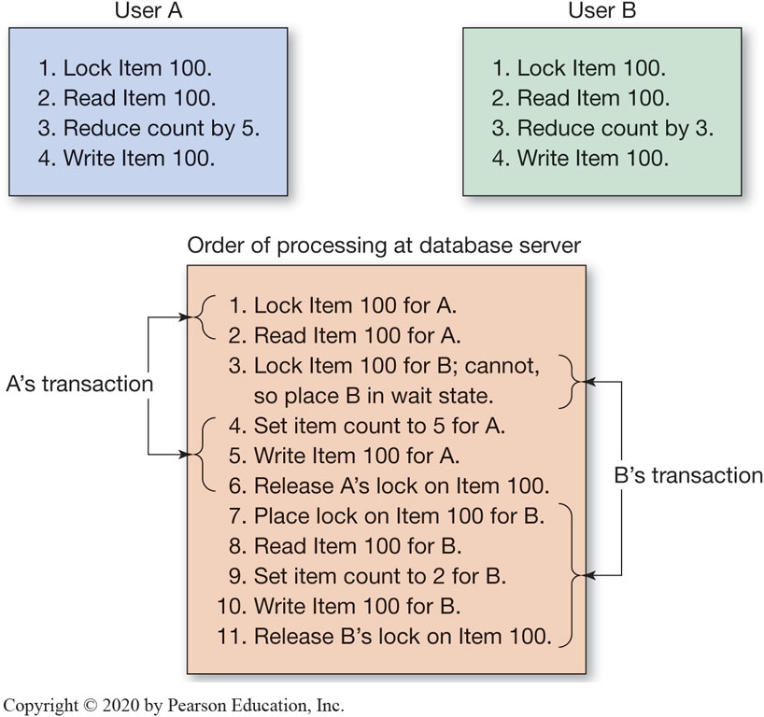
Figure 6.6 Example of Concurrent Processing with Explicit Locks

Slide 17
Serializable Transactions
Understand the use of locking and the problem of deadlock
When two or more transactions are processed concurrently, the results in the database should be logically consistent with the results that would have been achieved had the transactions been processed in an arbitrary serial fashion.
A scheme for processing concurrent transactions in this way is said to be serializable

Slide 18
Two-Phased Locking
Understand the use of locking and the problem of deadlock
One way to achieve serializable transactions is by using two-phased locking.
Two-phased locking lets locks be obtained and released as they are needed:
a growing phase, when the transaction continues to request additional locks
a shrinking phase, when the transaction begins to release the locks

Slide 19
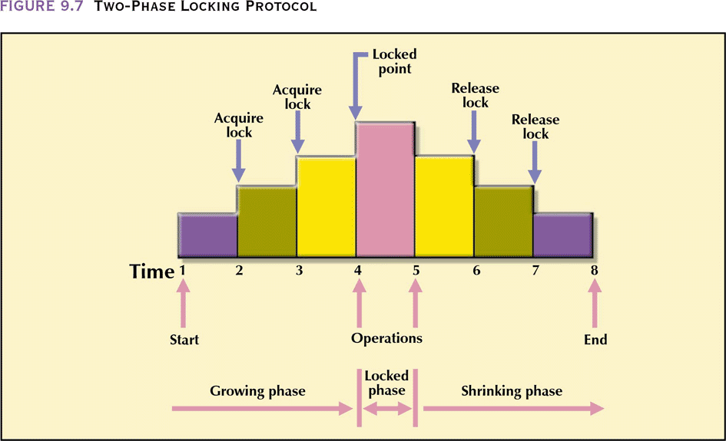
Two-Phase Locking Protocol

Slide 20
Deadlock
Understand the use of locking and the problem of deadlock
As a transaction begins to lock resources, it may have to wait for a particular resource to be released by another transaction.
Sometimes two transactions may indefinitely wait on each other to release resources. This condition is known as a deadlock or the deadly embrace.
This condition can lock up a computer preventing use by any user until it is fixed.

Slide 21
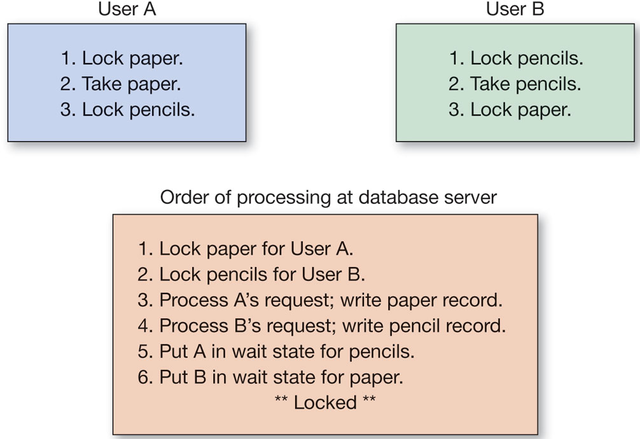
Figure 6.7 Examples of Deadlock

Slide 22
Optimistic Versus Pessimistic Locking
Learn the difference between optimistic and pessimistic locking
Optimistic locking assumes that no conflict will occur. Data are read, the transaction processed, updates are issued, and then a check is made to see if conflict occurred. If a conflict occurred it is rolled back and repeated until successful.
Pessimist locking assumes that conflict will occur, thus locks are issued, the transaction completed, and then the locks are released.

Slide 23
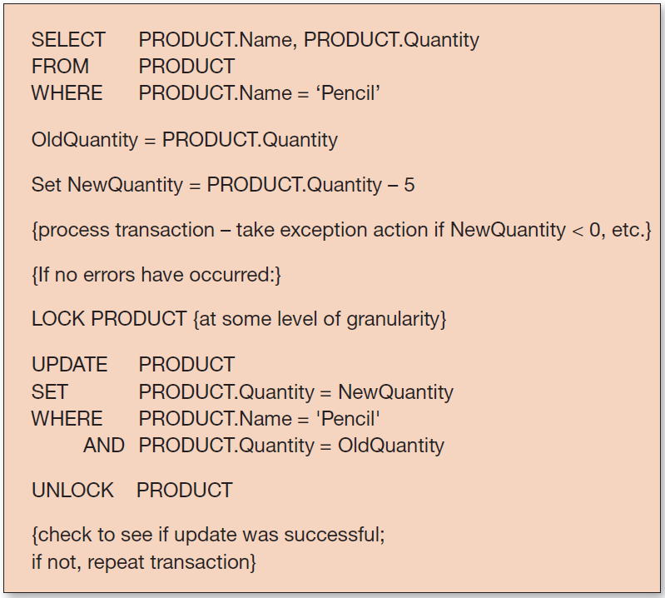
Figure 6.8 Example of Optimistic Locking

Slide 24
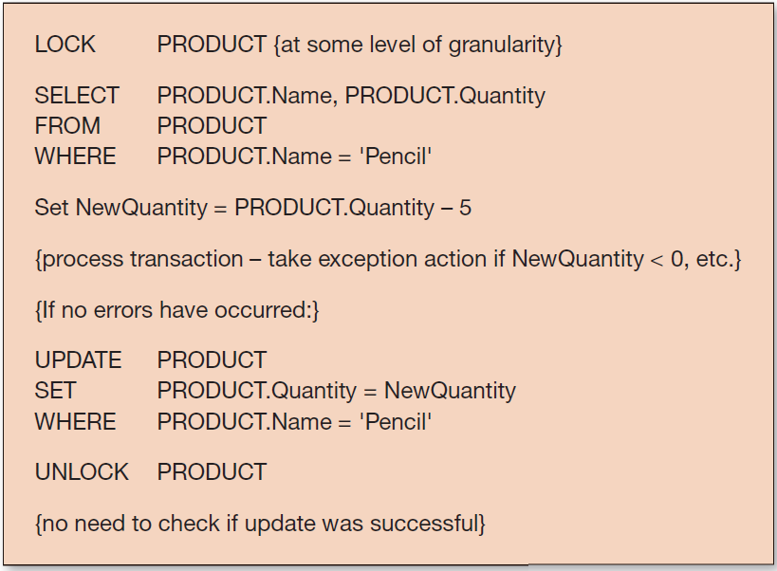
Figure 6.9 Example of Pessimistic Locking

Slide 25
SQL Transaction Control Language (T L C)
Learn the difference between optimistic and pessimistic locking
The SQL BEGIN TRANSACTION statement
The SQL COMMIT TRANSACTION statement
The SQL ROLLBACK TRANSACTION statement
Note: Exact SQL syntax varies between various DBMS products.

Slide 26
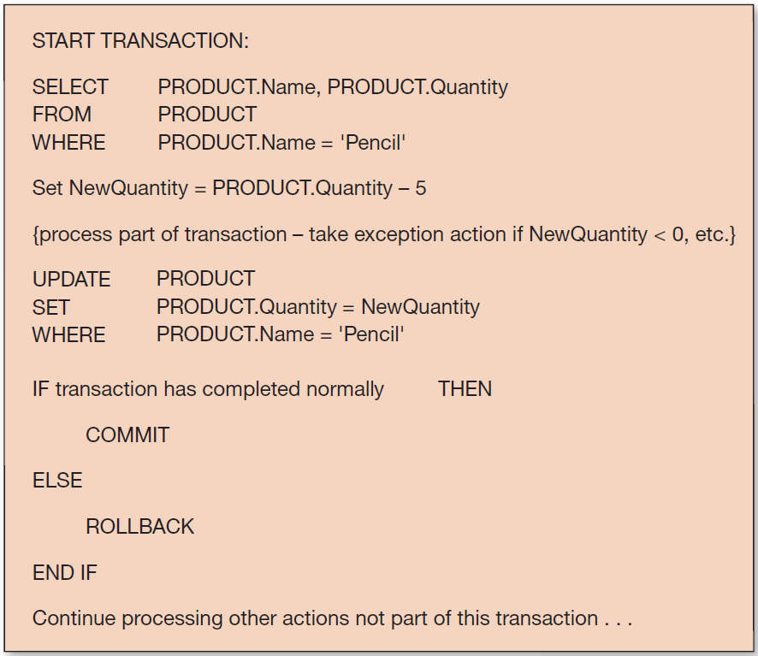
Figure 6.10 Example of Marking Transaction Boundaries

Slide 27
A C I D Transaction (1 of 2)
Know the meaning of A C I D transaction
Sometimes the acronym A C I D is applied to transactions.
An A C I D transaction is one that is atomic, consistent, isolated, and durable.
Atomic:
an atomic transaction is one in which all of the database actions occur, or none of them do
a transaction consists of a series of steps, each of which must be successful to be saved
Consistent
a consistent transaction means that no other transactions are permitted on the records until the current transaction finishes; referred to as statement level consistency among all records

Slide 28
A C I D Transaction (2 of 2)
Know the meaning of A C I D transaction
Isolation
because of multiuser environments, different transactions may be operating on the same data which can result in continuously changing data content
1992 A N S I SQL standard defines four isolation levels that specify which of the concurrency control problems are allowed
Durable
a durable transaction is one in which all committed changes are permanent

Slide 29
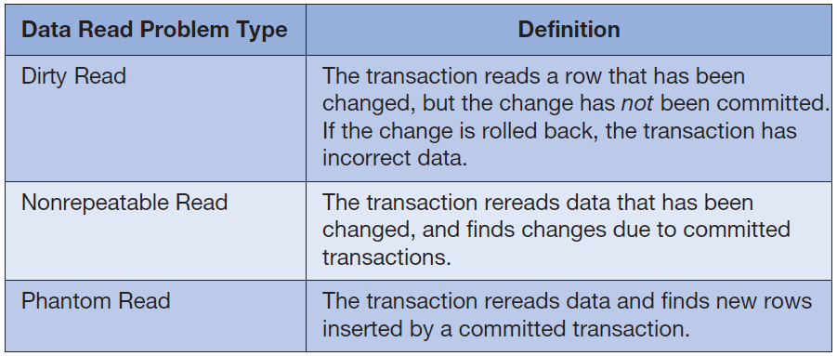
Figure 6.11 Summary of Data Read Problems

Slide 30
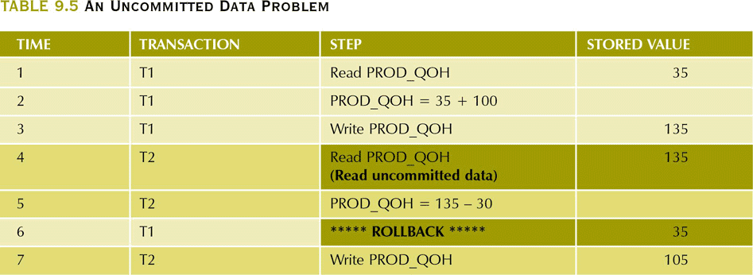
An Uncommitted Data Problem

Slide 31
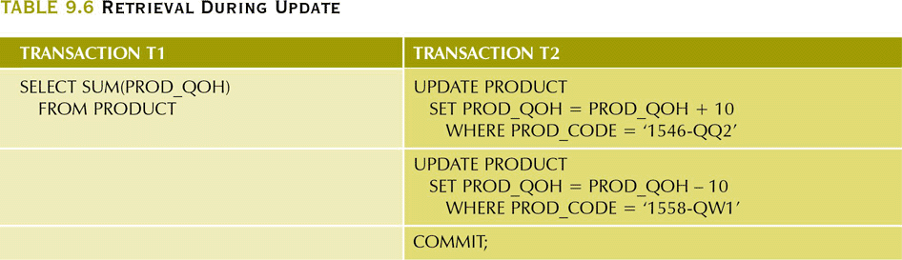
Retrieval During Update

Slide 32
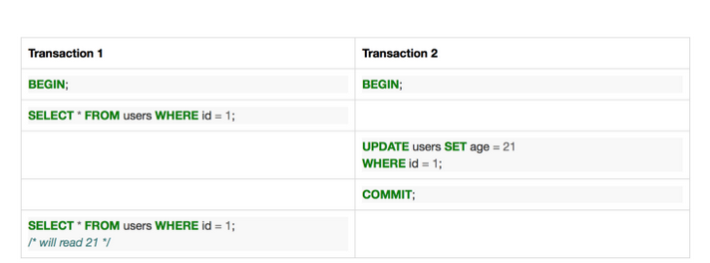
None-Repeatable Read

Slide 33
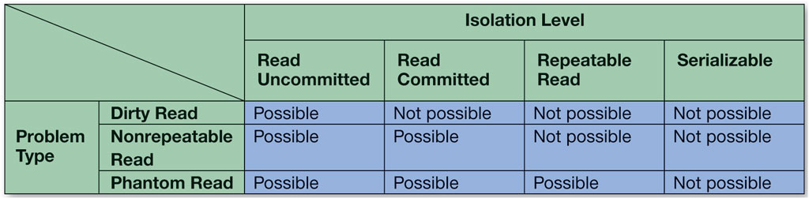
Figure 6.12 Summary of Isolation Levels

Slide 34
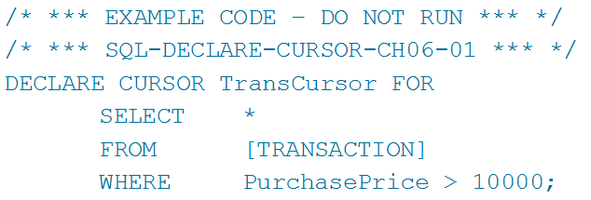
Cursor
Learn different ways of processing a database using cursors
A cursor is a pointer into a set of rows that is the result set from an SQL SELECT statement.
Cursors are usually defined using SELECT statements.

Slide 35
Cursor Types
Learn different ways of processing a database using cursors
Cursors can be forward only or scrollable.
In SQL Server, these cursors can be one of three different types:
static cursor (takes a snapshot and processes it)
dynamic cursor (a fully featured cursor)
keyset cursor (combines some features of static and some of dynamic cursors)
Other DBMS products may define a different set of cursors.

Slide 36
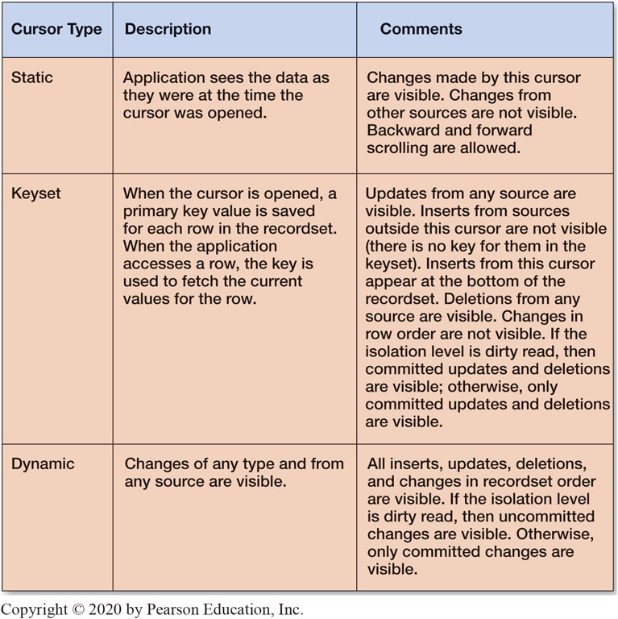
Figure 6.13 Summary of Cursor Types

Slide 37
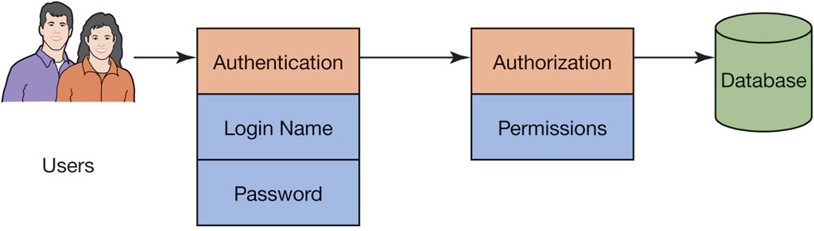
Figure 6.14 Database Security Authentication and Authorization
Database security strives to ensure that:
only authorized users
perform authorized activities

Slide 38
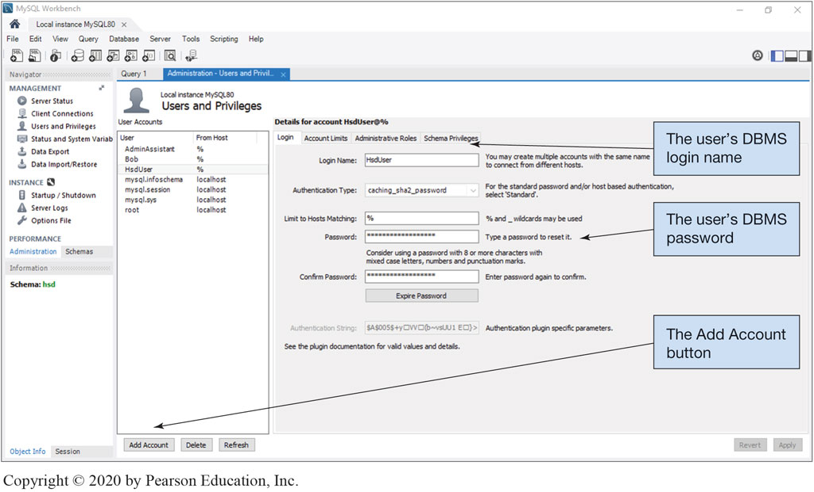
Figure 6.15 Creating the MySQL User Login
Oracle MySQL Community Server 8.0, Oracle Corporation

Slide 39
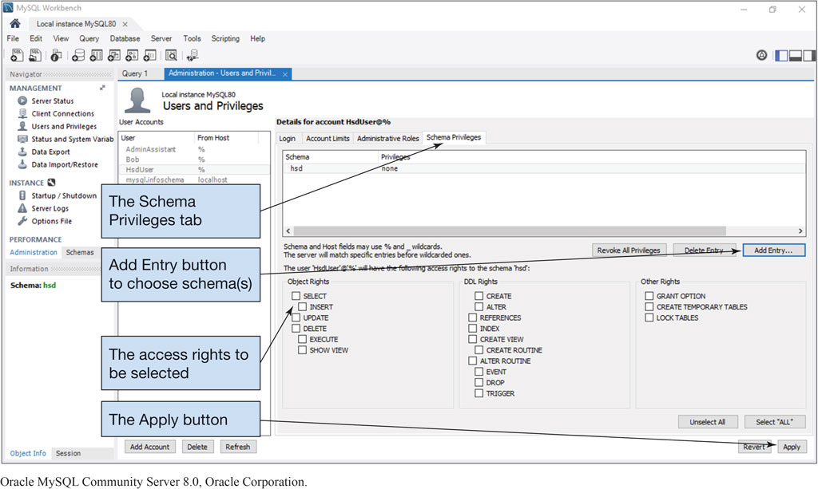
Figure 6.16 Using the Workbench to Grant Privileges to a Database Schema
Oracle MySQL Community Server 8.0, Oracle Corporation

Slide 40
User Processing Rights and Responsibilities
Understand the need for security and specific tasks for improving database security
Processing rights define who is permitted to do what, and when they can do it.
The individuals performing these activities have full responsibility for the implications of their actions.
An important principle of database security administration is that administrative permissions are given to user groups (also known as user roles) and not to individual users unless necessary.
Individuals are identified by a username and a password.

Slide 41
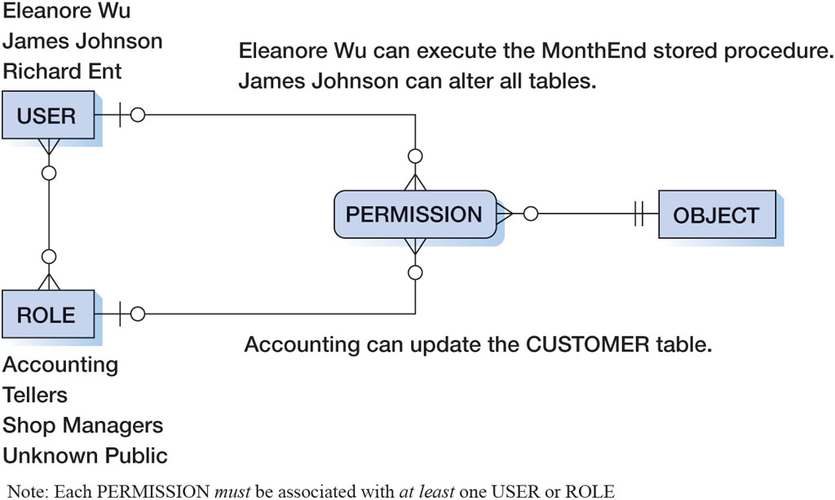
Figure 6.17 A Model of DBMS Security

Slide 42
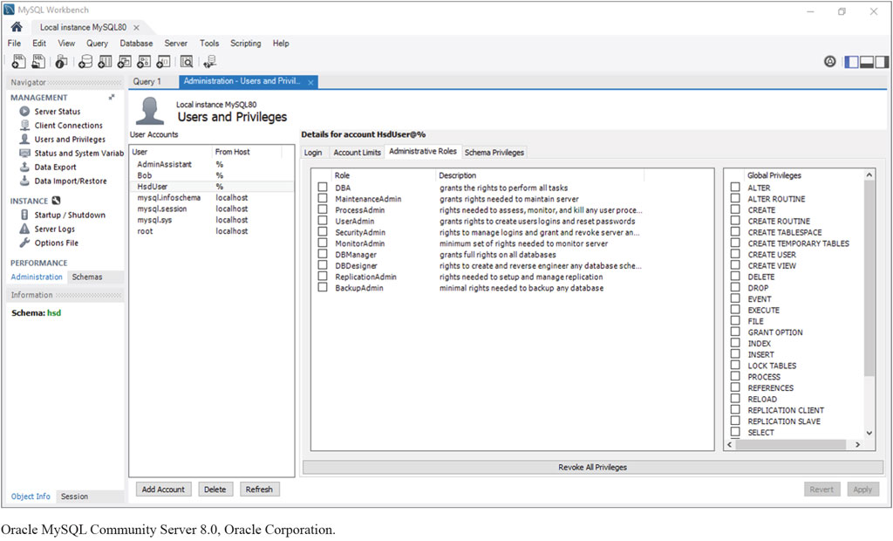
Figure 6.18 MySQL Administrative Roles
Oracle MySQL Community Server 8.0, Oracle Corporation

Slide 43
Figure 6.19 Processing Rights at Heather Sweeney Designs
DATABASE RIGHTS GRANTED
Table | Administrative Assistants | Management | System Administrator
SEMINAR | Read, Insert, Change | Read, Insert, Change, Delete | Grant Rights, Modify Structure
CUSTOMER | Read, Insert, Change | Read, Insert, Change | Grant Rights, Modify Structure
SEMINAR_ CUSTOMER | Read, Insert, Change, Delete | Read, Insert, Change, Delete | Grant Rights, Modify Structure
CONTACT | Read, Insert, Change | Read, Insert, Change, Delete | Grant Rights, Modify Structure
INVOICE | Read, Insert, Change | Read, Insert, Change, Delete | Grant Rights, Modify Structure
LINE_ITEM | Read, Insert, Change, Delete | Read, Insert, Change, Delete | Grant Rights, Modify Structure
PRODUCT | Read, Insert, Change | Read, Insert, Change, Delete | Grant Rights, Modify Structure

Slide 44
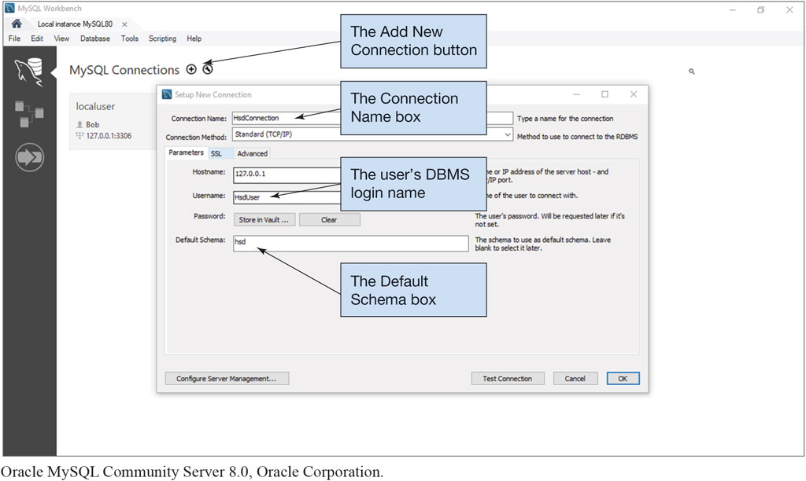
Figure 6.20 Creating a New Connection for HsdUser
Oracle MySQL Community Server 8.0, Oracle Corporat

Slide 45
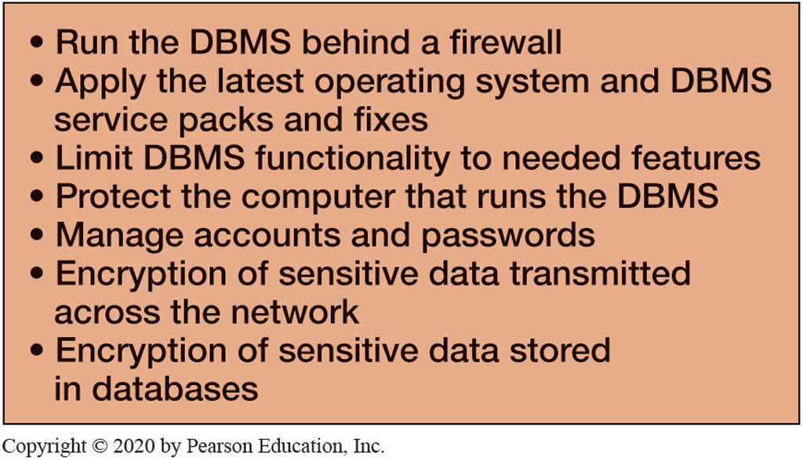
Figure 6.21 DBMS Security Guidelines

Slide 46
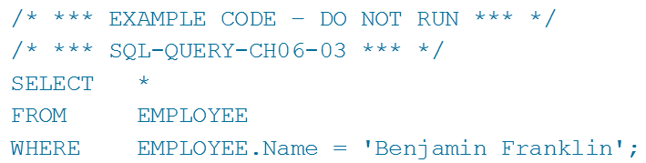
Application-Level Security
Understand the need for security and specific tasks for improving database security
Application level security is often provided on the Web server computer.
When application security is executed on this server, sensitive security data do not need to be transmitted over the network.
For example, when users (who are logged in) click a particular button on a browser page, the following query is sent to the Web server and then to the DBMS

Slide 47
Database Backup and Recovery
Know the difference between recovery via reprocessing and recovery via rollback/rollforward
Common causes of database failures:
hardware failures
programming bugs
human errors/mistakes
malicious actions
As these issues are impossible to completely avoid, recovery procedures are essential.

Slide 48
Recovery via Reprocessing
Know the difference between recovery via reprocessing and recovery via rollback/rollforward
In reprocessing, all activities since the backup was performed are redone.
The time it takes to do this is the same amount of time it took when first entered.
One downside is that if the system is heavily scheduled, it might never catch up.

Slide 49
Recovery via Rollback & Rollforward
Know the difference between recovery via reprocessing and recovery via rollback/rollforward
Most database management systems provide a mechanism to record activities into a log file.
to undo a transaction the log must contain a copy of every data-base record before it was changed
such records are called before-images
a transaction is undone by applying before-images of all its changes to the database
to redo a transaction the log must contain a copy of every database record (or page) after it was changed
these records are called after-images
a transaction is redone by applying after-images of all its changes to the database
The log file is then used for recovery via rollback or rollforward.

Slide 50
Rollforward
Know the difference between recovery via reprocessing and recovery via rollback/rollforward
Activities recorded in the log files may be replayed.
In doing so, all activities are reapplied to the database.
This procedure is used to resynchronize restored database data by adding transactions to the last full backup.

Slide 51
Rollback
Know the difference between recovery via reprocessing and recovery via rollback/rollforward
Log files save activities in sequence order.
It is possible to undo activities in reverse order that they were originally executed.
This is performed to correct or undo erroneous or malicious transaction(s) after a database is recovered from a full backup.

Slide 52
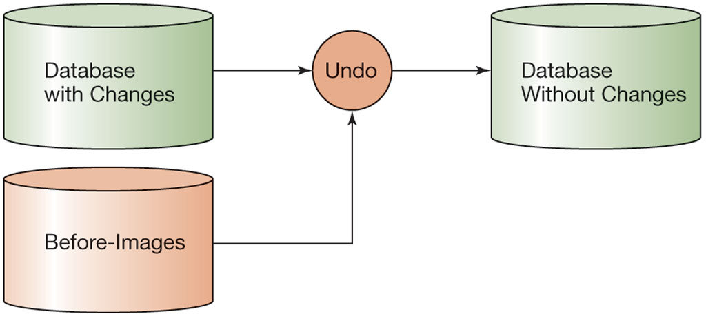
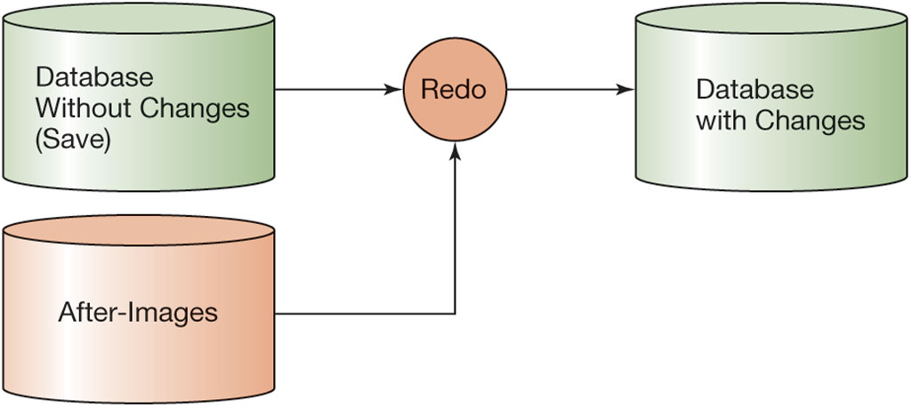
Figure 6.22 Undo and Redo Transactions

Slide 53
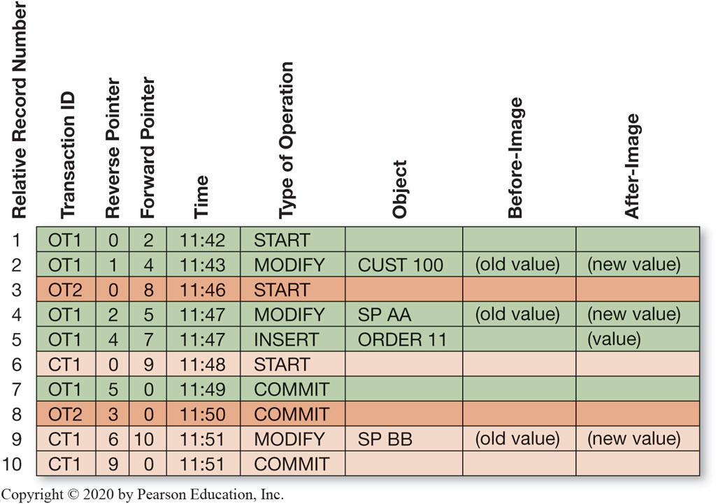
Figure 6.23 Transaction Log Example

Slide 54
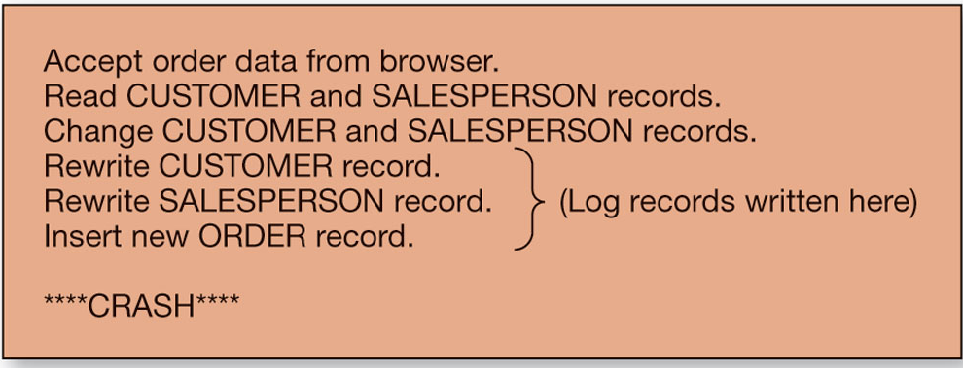
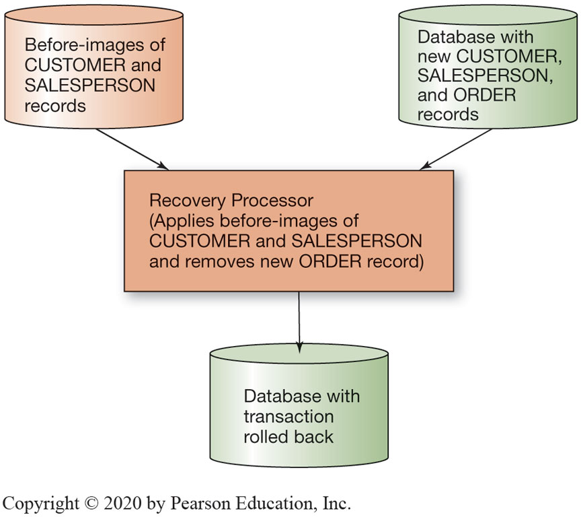
Figure 6.24 Recovery Example

Slide 55
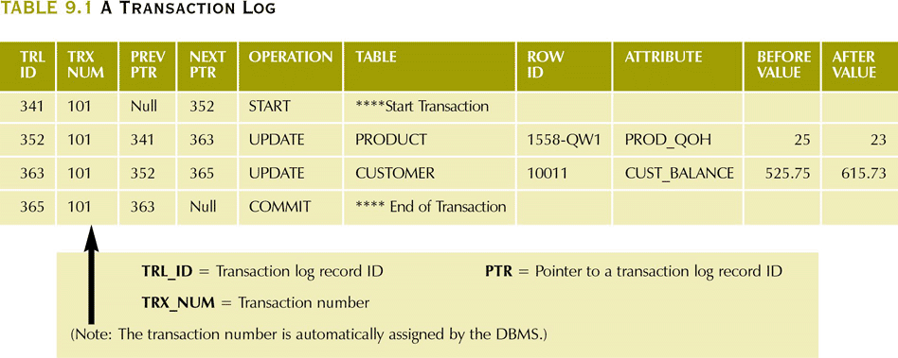
A Transaction Log

Slide 56
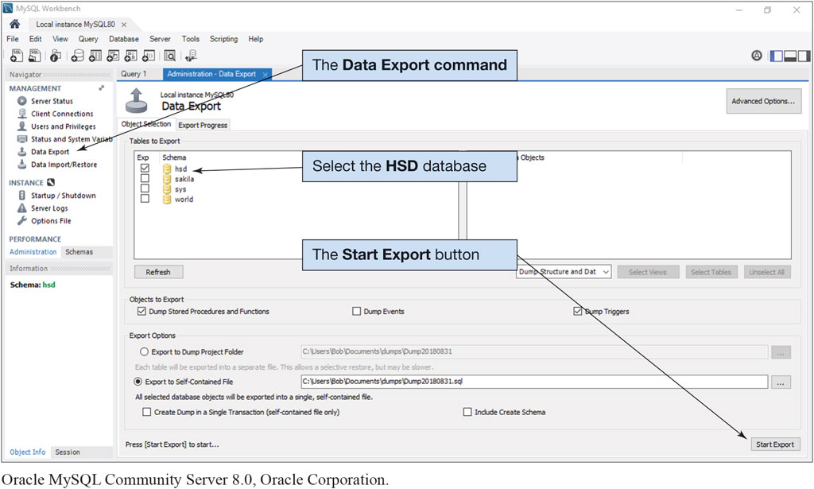
Figure 6.25 Backing Up the H S D Database
Oracle MySQL Community Server 8.0, Oracle Corporation

Slide 57
Additional D B A Responsibilities (1 of 2)
Know basic administrative and managerial D B A functions
The D B A needs to ensure that a system exists to gather and record user-reported errors and other problems:
a method must be devised to prioritize those errors and problems and to ensure that they are corrected accordingly
The D B A needs to create and manage a process for controlling the database configuration:
procedures for recording change requests
conducting user and developer reviews of such requests
creating projects and tasks

Slide 58
Additional D B A Responsibilities (2 of 2)
Know basic administrative and managerial D B A functions
The D B A is responsible for ensuring that appropriate documentation is maintained:
database structure
concurrency control
security and backup and recovery
applications used
Every organization should have a Service Level Agreement with the cloud provider that covers backups, application response time, and error reporting.

Slide 59

Copyright
This work is protected by United States copyright laws and is provided solely for the use of instructors in teaching their courses and assessing student learning. Dissemination or sale of any part of this work (including on the World Wide Web) will destroy the integrity of the work and is not permitted. The work and materials from it should never be made available to students except by instructors using the accompanying text in their classes. All recipients of this work are expected to abide by these restrictions and to honor the intended pedagogical purposes and the needs of other instructors who rely on these materials.
Notes:
If this slide was not included in the original PPT, it should be added.

